Slide 1
Catheter Placement
Group 2.
Notes:
Charles

Slide 2

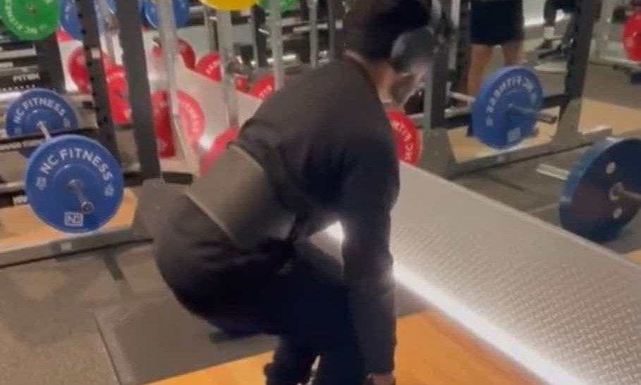





This is our team.
Byron Shim
Yohan Nanayakkara
Jaehong Kang
Charles Connell
Aden Siau
Stefano Nicholas Rusli
Avish Narayan
Notes:
Charles

Slide 3
Table of contents.
01
Introduction
02
What is a catheter?
03
Exploratory Data Analysis
04
Modelling
05
Conclusion
Notes:
Charles

Slide 4
Introduction
01
Notes:
Yohan

Slide 5
Context
Medical devices using in medical procedures to perform functions such as removing fluids or delivering medication
Placed in veins connecting to stomach or heart
Medical complications can arise due to malpositioned lines/tubes in patients
Early detection can be extremely beneficial
Notes:
Yohan
So Catheters and tubes are essentially medical devices used in various medical procedures to perform functions such as removing fluids or delivering medication
Depending on the type they can be inserted into a large vein, the stomach or the space between your lungs
Medical issues can occur due to malpositioned lines/tubes in patients
Probability of human error goes up when hospital capacity for that treatment goes up

Slide 6
Benefits and implications
Benefits
Mitigate risk of human error
Early detection of complications
Faster decision making
implications
Increased reliance of ai use for diagnostics
Ethical and legal considerations
Notes:
Yohan
Some of the benefits include reducing human error, early detection of misplaced catheters and faster decision making, which could be crucial depending on the situation
A successful model would likely lead to greater adoption of AI-based tools in radiology and diagnostic processes. Clinicians may increasingly rely on machine learning models to assist with interpreting medical images
As AI tools influence patient outcomes, legal frameworks may need to evolve to address questions of liability. For example, if a misdiagnosis occurs due to an AI system’s error

Slide 7
Benefits to Everyday Person
Specific to catheters:
Classifying the catheter type
Determining if position is correct
In general:
Can be applied to other X-rays such as broken bones
Automating detection can reduce wait times
Process will be faster and cheaper
Notes:
yohan
So
Once a chest X-ray is taken, the image can be analyzed by a model trained to detect the position of catheter placements the type of catheter and identifying any mispositioned tubes within seconds
In a more general standpoint
It can take up to 3 or more hours for just for an X-ray result for a broken bone. With automated systems powered by deep learning models, this process can become much effecient. Once the X-ray is taken, it can be run through a trained model that could classify if it serious or not, thus cutting costs by reducing the need for staff as well and patients get their results faster.

Slide 8
Project goals
Create a range of binary classification models that detects each catheter type
Create a multi-label classification model that can determine the positioning of a certain type of catheter
This will allow incorrectly positioned catheters to be identified faster, speeding up processes and ensuring procedures are done correctly.
Notes:
Charles

Slide 9
What is a Catheter?
02
Notes:
Byron

Slide 10
Catheter Classifications
Types of catheters:
NGT
ETT
CVC
Classifications:
Normal
Abnormal
Borderline
Incompletely Imaged

Slide 11
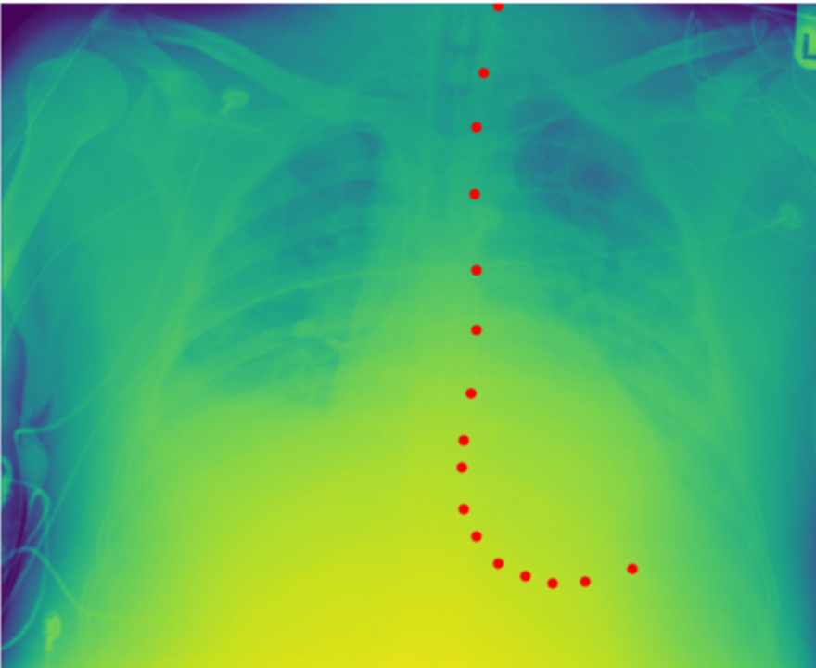
NGT - Nasogastric Tube (Normal)
Place of insertion:
Nostril
Mouth
Where it sits:
Down the esophagus, in the stomach
What it does:
Delivers food or medicine
Draw substances out, e.g. poisons
Notes:
Byron

Slide 12
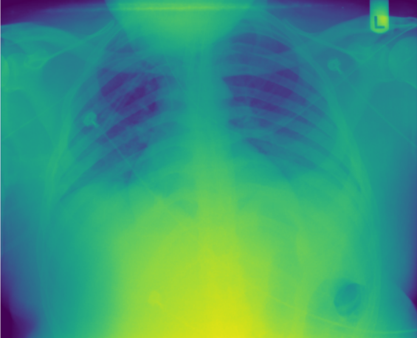

NGT Abnormal
Notes:
Byron

Slide 13
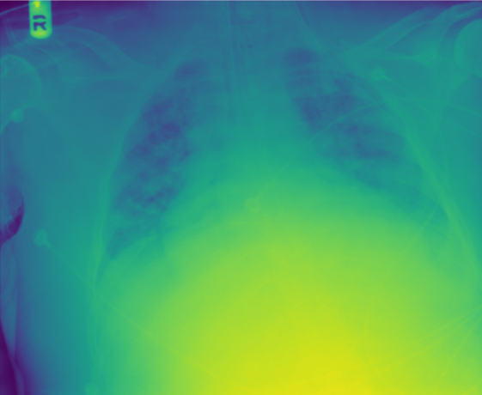
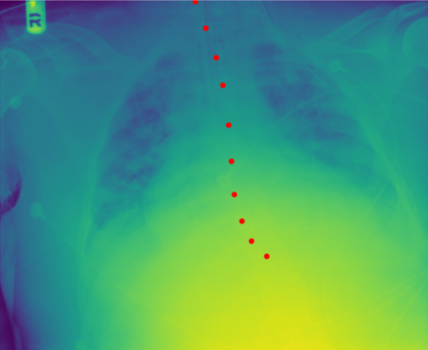
NGT Borderline
Notes:
byron

Slide 14
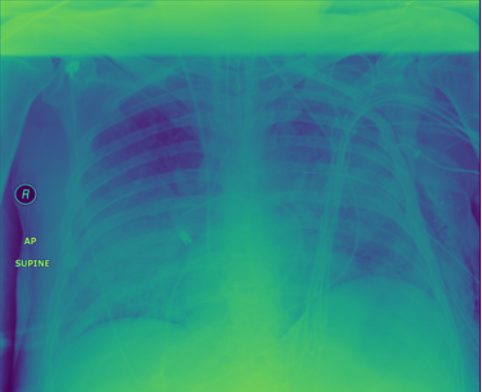
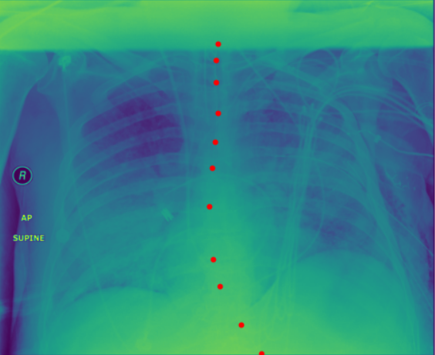
NGT Incompletely Imaged
Notes:
byron

Slide 15
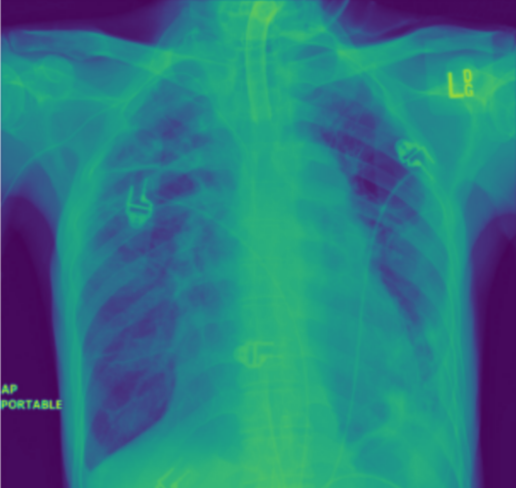
ETT - Endotracheal Tube (Normal)
Place of insertion:
Mouth (common in emergencies) or nose
Where it sits:
In the windpipe
Just below the collarbones
What it does:
Keeps the airway open
Provides uncontaminated oxygen, medicine or anesthesia
Notes:
byron

Slide 16
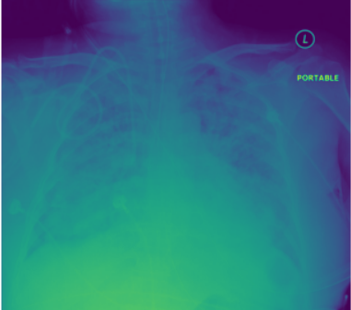
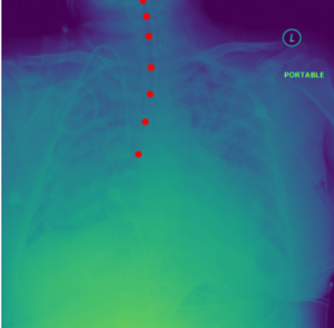
ETT Abnormal
Notes:
byron

Slide 17
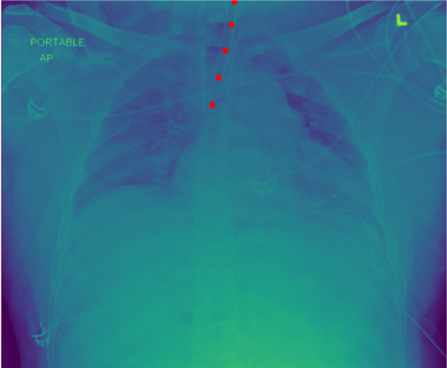
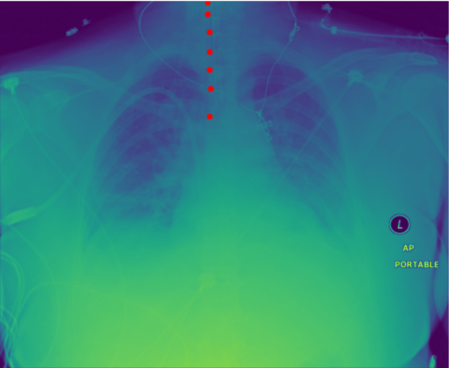
ETT Borderline
Notes:
byron

Slide 18
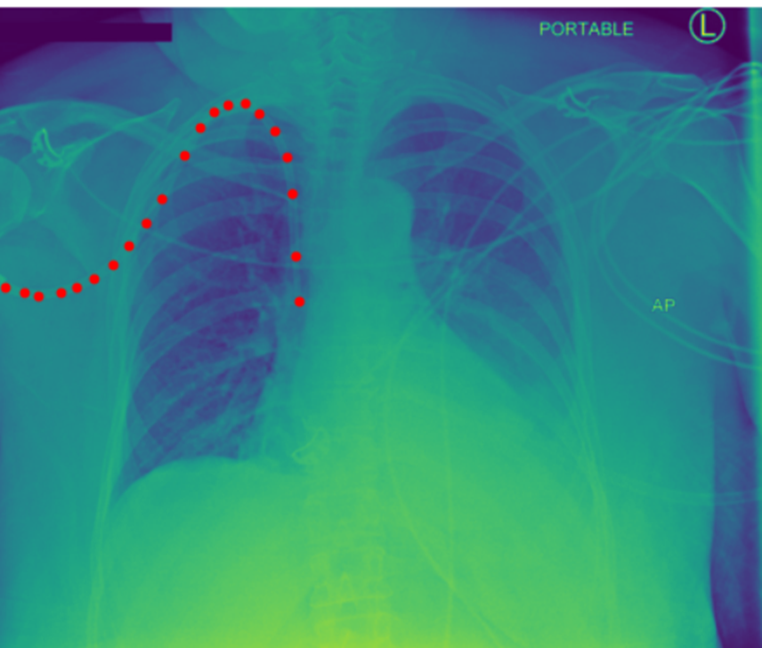
CVC - Central Venous Catheter (Normal)
Place of insertion:
PICC (Peripherally inserted central catheter) inserted in arm
Subclavian vein or neck
Where it sits:
Ideally the vena cava (large vein just before the right atrium)
This is so intravenous fluids can be pumped through the body as quickly as possible
What it does:
Mainly administers medication
Notes:
byron

Slide 19
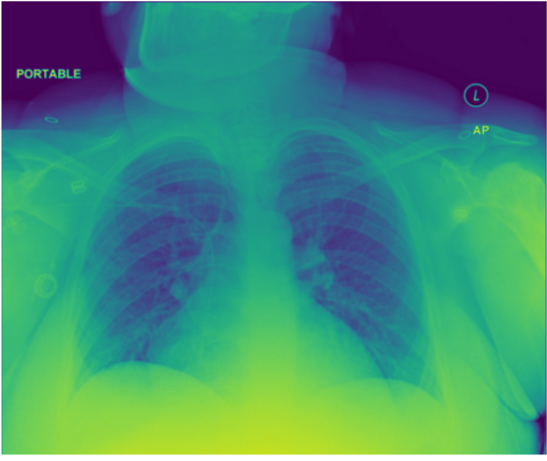
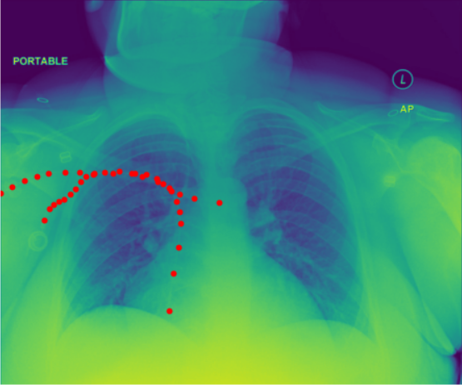
CVC Abnormal
Notes:
byron

Slide 20
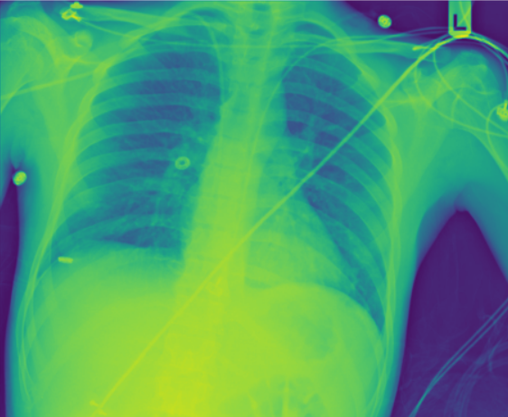
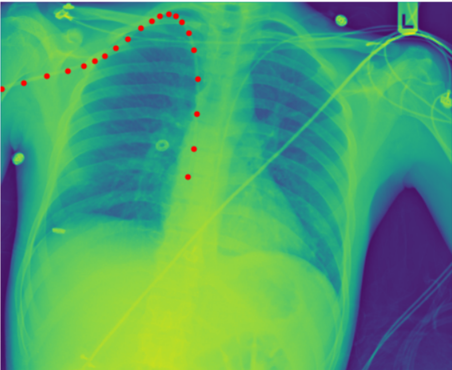
CVC Borderline
Notes:
byron

Slide 21
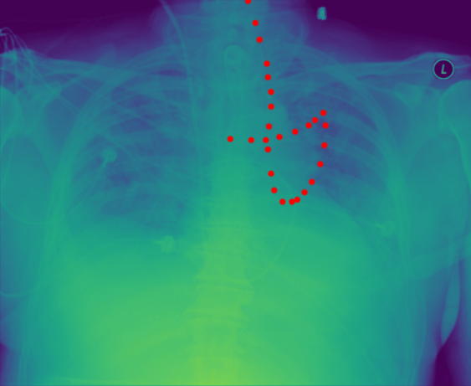
Swan Ganz - Type of CVC
Does more than a normal cvc, it can measure:
Cardiac Output
Left atrial pressure
Pulmonary artery pressure
Where it sits:
Pulmonary artery - between right ventricle and lungs
Provides information about heart strength and health
Notes:
byron

Slide 22
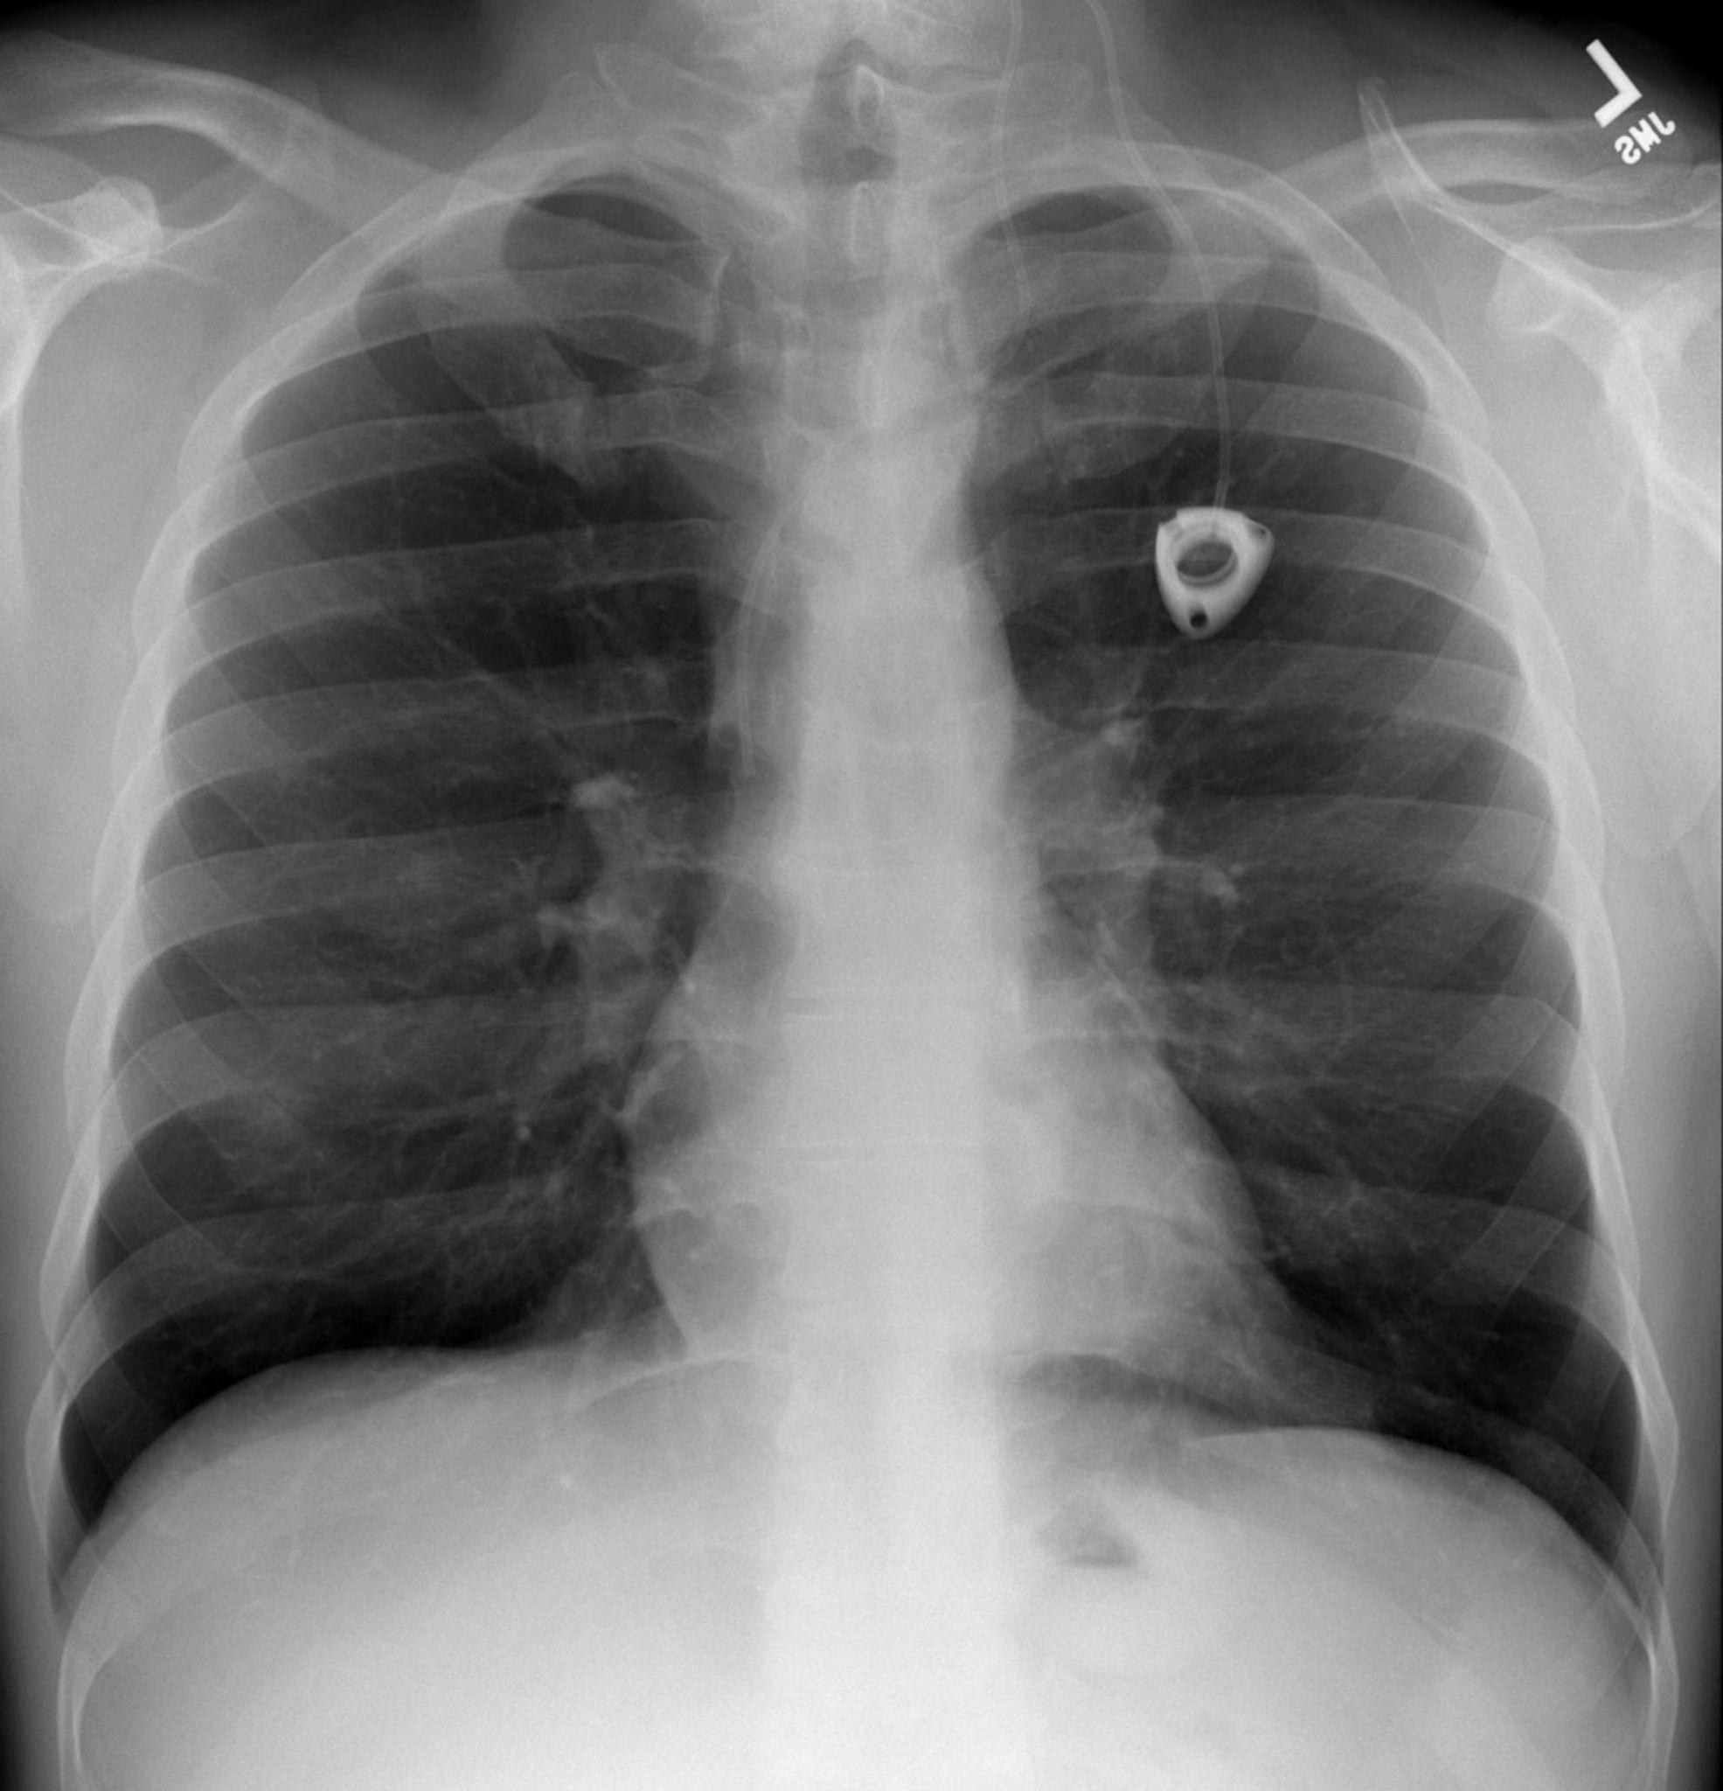
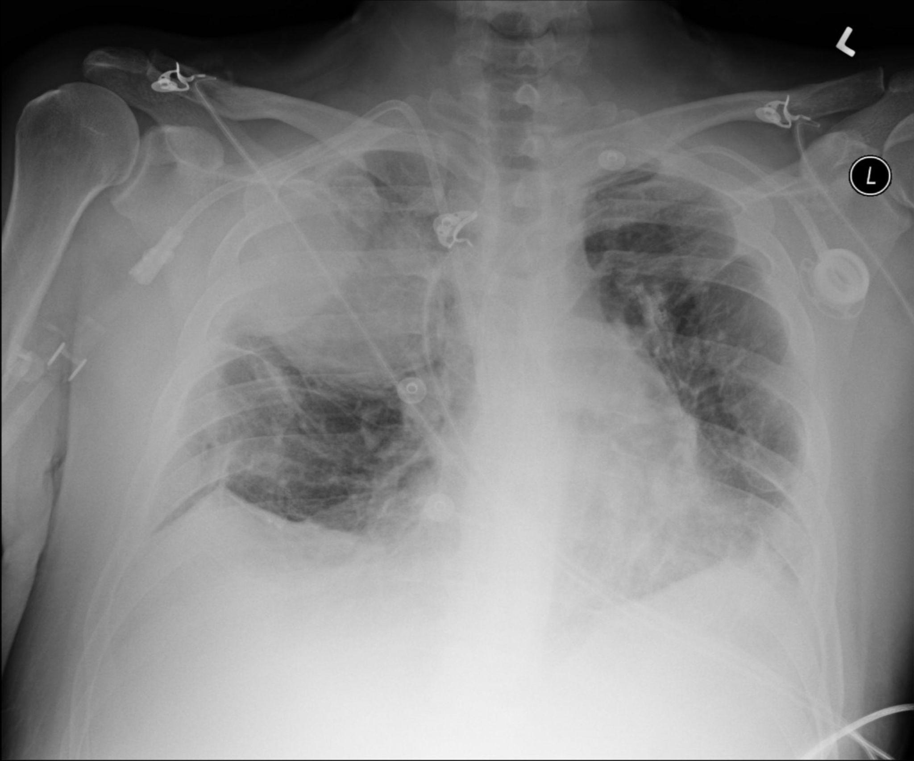
Data We Received
Images:
Folder with 30083 images
Each image is a medical scan that contains a number of catheters
Train CSV:
CSV that indicates what catheter types are present in a particular image
Annotations:
Each row provides the coordinates of a catheter present in an image
18000 annotations
9095 unique images
Notes:
Aden

Slide 23

Data
The data received was already clean:
No duplicates
No missing values

Slide 24
Exploratory Data Analysis
03
Notes:
Nic

Slide 25
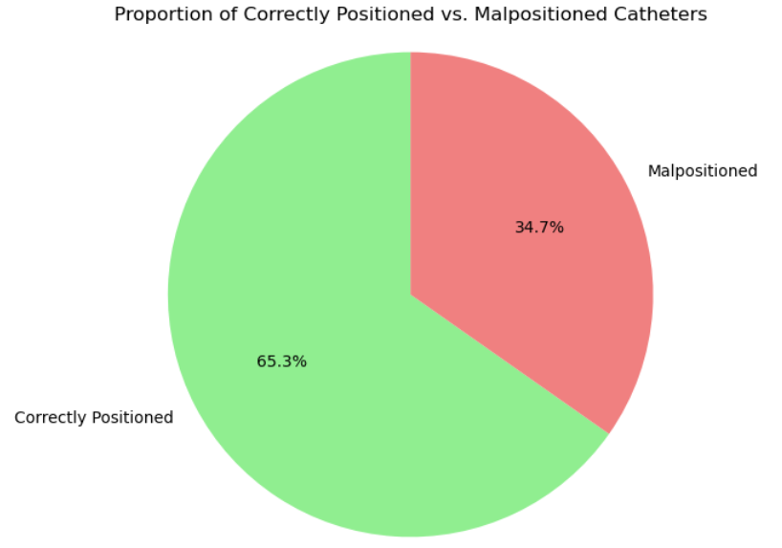
Positioned vs Malpositioned
Notes:
Nic
Talk about one of the percentages, what malpositioned even means in this context (abnormal, borderline, incompletely imaged)

Slide 26
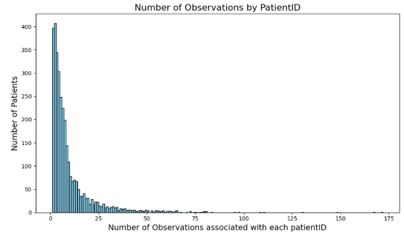
Number of Observations
Notes:
Nic
There are many patients with several recorded observations / studies. Nearly 90% of patients have more than one observation.

Slide 27
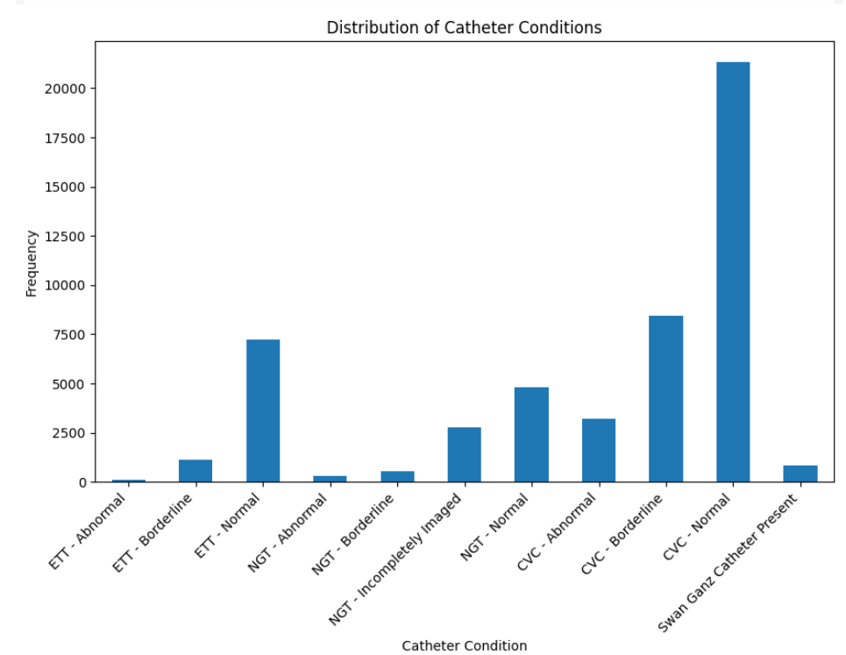
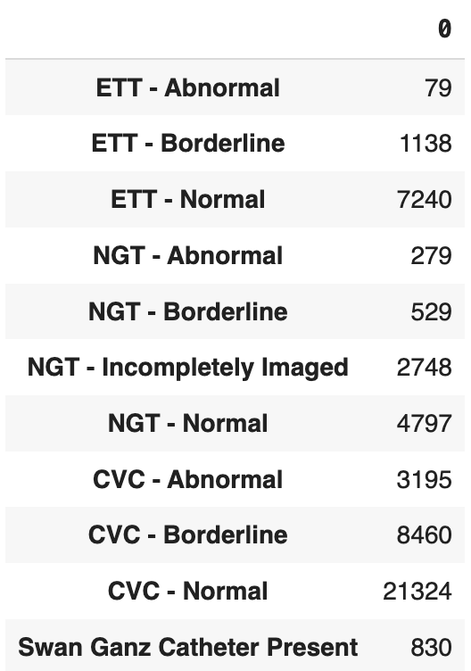
Distribution of Catheters
Notes:
Nic
When checking the distribution of Catheters, CVC-normal has the highest frequency of over 20 thousand, which is why we chose to classify this first in our model.

Slide 28
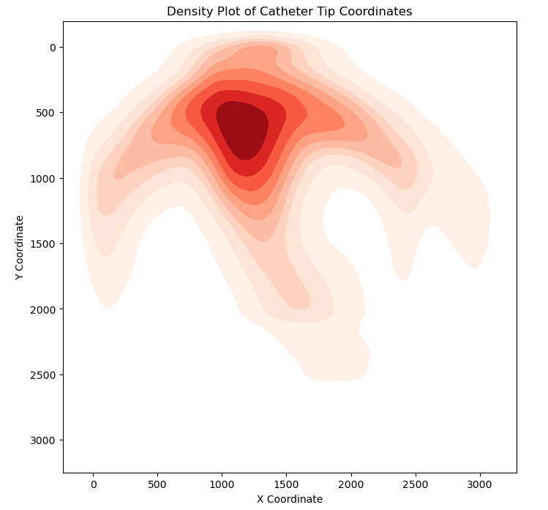
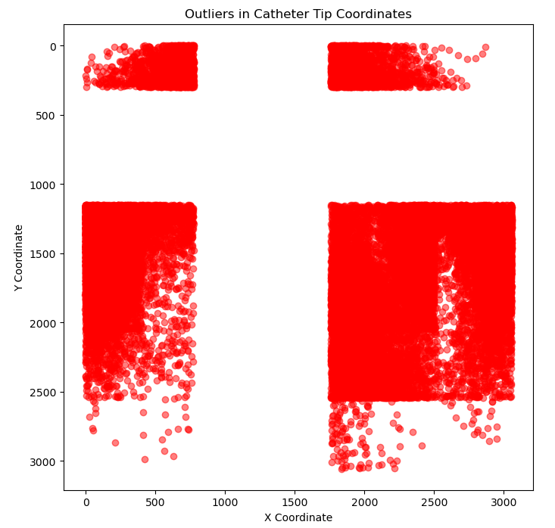
Concentration and Outliers
Notes:
Nic
Catheter tips - end points of catheters location are represented in the density plot, where most of the tips are concentrated in the central darker region.
This likely corresponds to CVC-normal since the dataset consists of 70% of that, while the lighter shades represent areas with less tips, which corresponds to malpositioned CVCs or other catheters.

Slide 29
Preprocessing and Data Manipulation + Modelling
04
Notes:
Jae

Slide 30
Deep Neural Network architecture
For modelling we decided to predominantly use the pre-built model in ResNet50:
Other CNN models performed worse or the same
ResNet is more suitable:
In medical image classification, small details can be crucial for distinguishing between different types of abnormalities in catheters (utilises 50 layers)
Stronger learning capabilities
Most efficient
Notes:
Jae

Slide 31
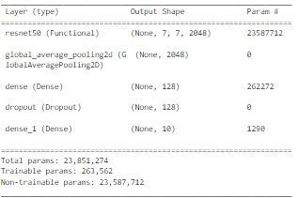
ResNet50 Architecture
Custom layers on top include a global average pooling layer, a dense layer with 128 units, dropout layer to prevent overfitting, and a dense output layer.
Overall using 50 layers from ResNet and 4 custom layers
Notes:
Jae

Slide 32
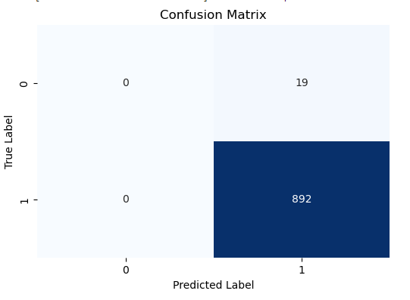
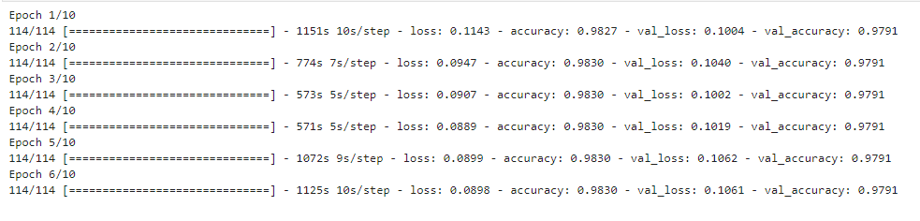
Binary Classification: CVC
As CVC catheters were the most prevalent, we first looked at categorising catheters as CVC or non-CVC
Trained on the whole data set (30083 images)
Obtained extremely high accuracies
Confusion matrix is from a smaller subset however reflects what is occurring
Notes:
Aden

Slide 33




Binary Classification 2: CVC
Due to the imbalance between CVC and non-CVC the model was biased and inaccurate
Applying weights to the model
Upsampling non-CVC catheters
Second attempt:
Filtered data to only images with annotations
20% validation split
Original
Upsampled
Original
Upsampled
Notes:
Aden

Slide 34
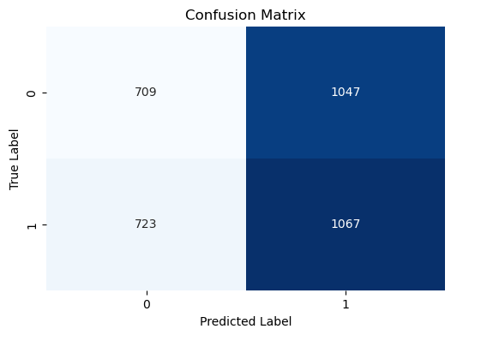
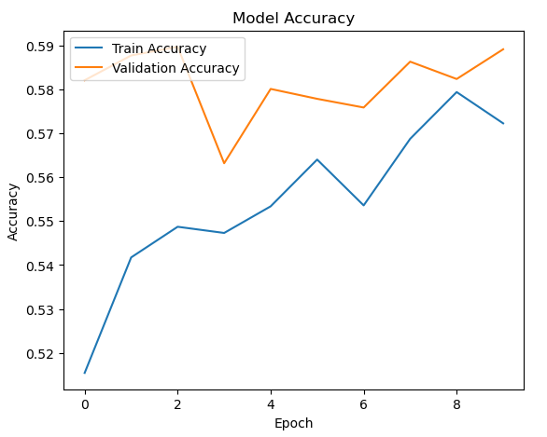
Binary Classification: CVC results
Notes:
Aden

Slide 35
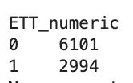
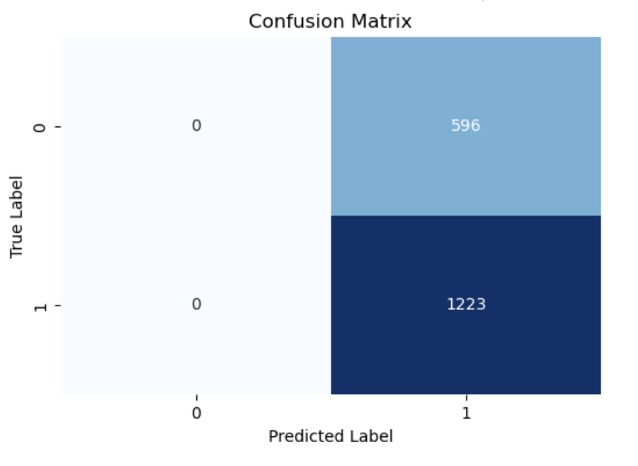
Binary Classification: ETT
We also looked at classifying ETT catheters as ETT or non-ETT
ETT catheters were less prevalent
Ratio between ETT and non-ETT seemed more balanced than CVC (expected a higher accuracy)
Notes:
Aden

Slide 36

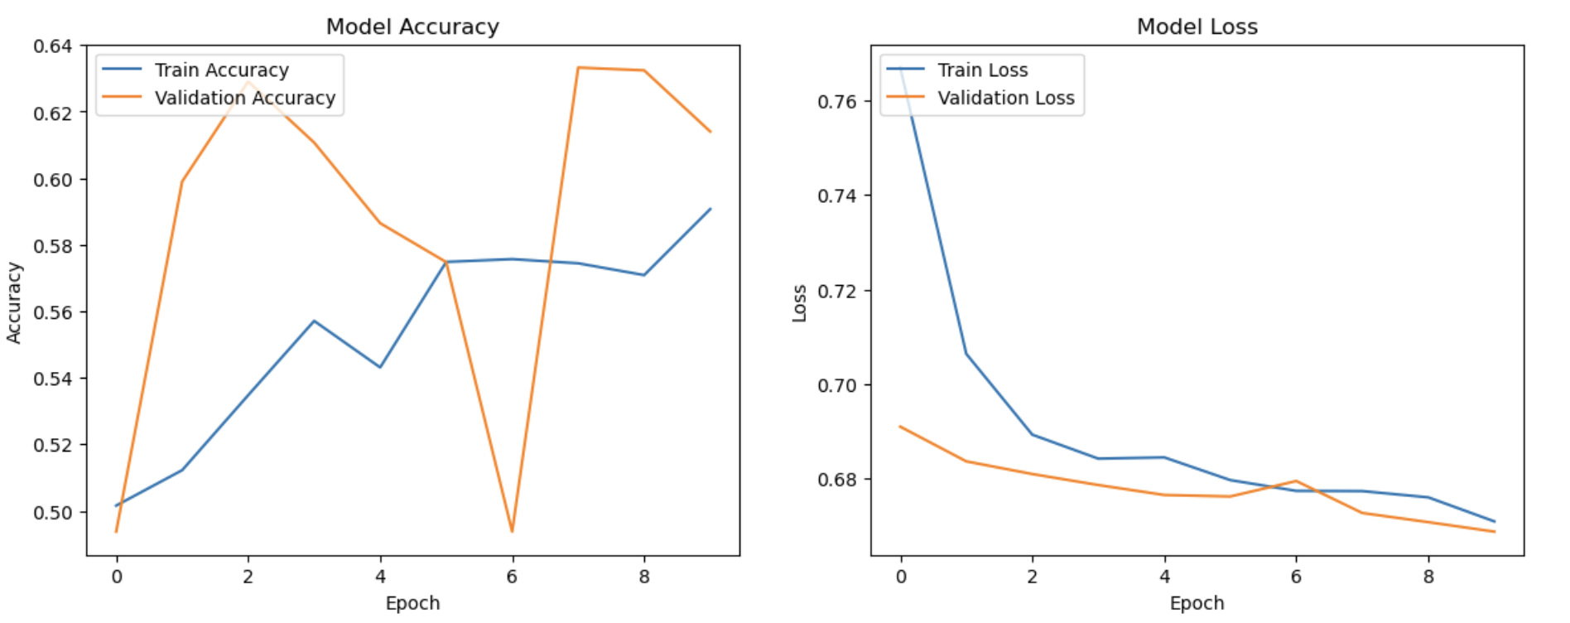
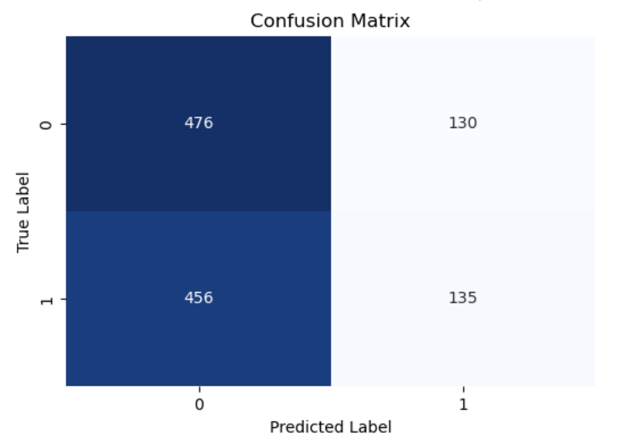
Binary Classification: ETT 2
Down-sampled
Notes:
Aden

Slide 37
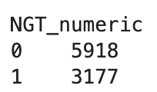
Binary Classification: NGT
Built a model to classify images as ‘NGT’ or ‘non-NGT’
The distribution of NGT to non-NGT images was much more even compared to CVC and ETT
Notes:
Aden

Slide 38


Categorical: Multi-label CVC Catheter Classification Setup
Due to software limitations, we only worked with X-ray images with only one catheter present
Created categorical columns classifying the catheters
Removed multiple catheter instances for software efficiency
Upsampled abnormal and borderline data for balancing
Only focussed on annotated data
Notes:
Jae

Slide 39
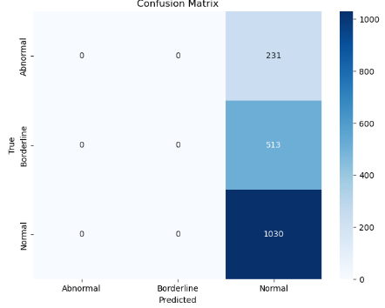
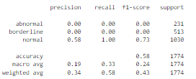
Categorical: Multi-label CVC Catheter Classification Initial results
Notes:
Jae

Slide 40
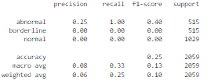
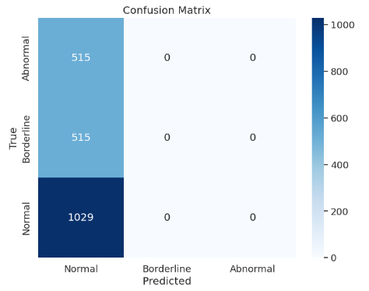
Categorical: Multi-label CVC Catheter Classification Balanced Results
Notes:
Jae

Slide 41
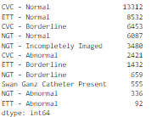
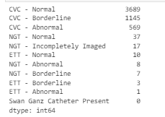
Categorical: Multi-label Catheter Classification setup
17999 studies
Due to software limitations, we only worked with X-ray images with only one catheter present
With significant undersampling, we added class weights
Created categorical columns classifying the catheters
Notes:
Jae

Slide 42
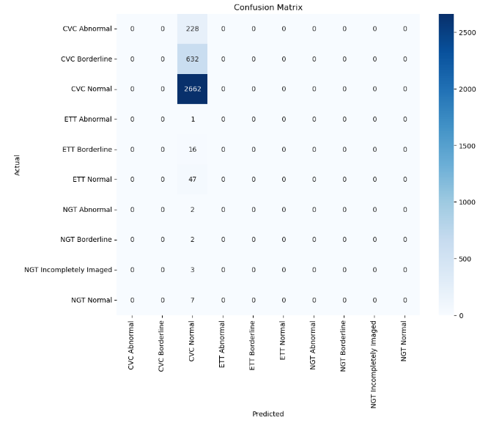
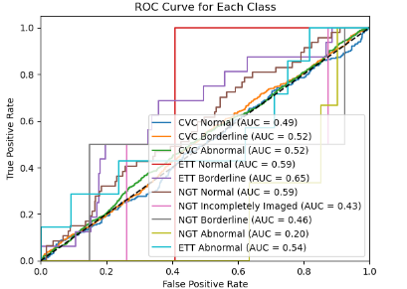
Multi-label Catheter Classification Results
Notes:
Jae

Slide 43
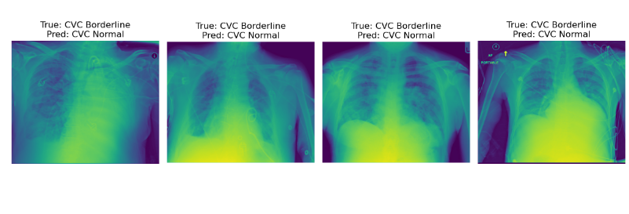
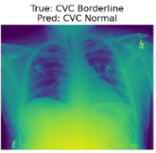
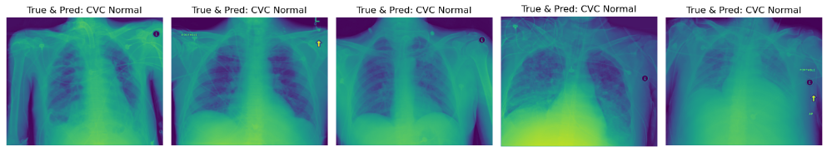
Categorical: Multi-label Catheter Classification True vs Predicted
Notes:
Jae
Fluid or fat built up

Slide 44
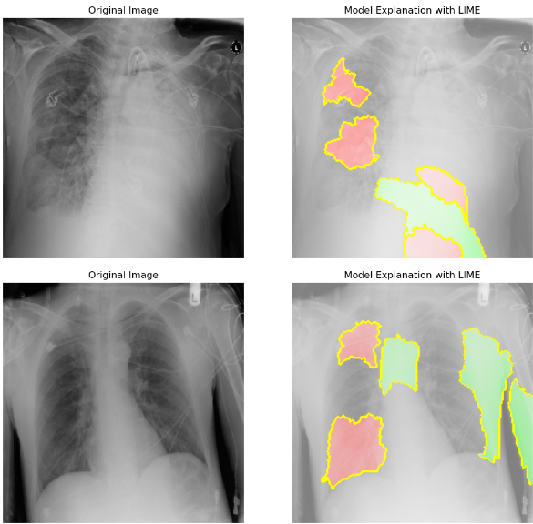
Model Interpretation - LIME
Highlights - the parts that most influence the models prediction. Shows that the model is focusing on the correct anatomical features related to the catheter type.
Green - positive influence.
Red - negative influence
LIME (Local Interpretable
Model-agnostic Explanations)
explains individual predictions
by identifying parts of the input
(like regions in an image) that
most influence the model's
decision.
Notes:
Avish

Slide 45
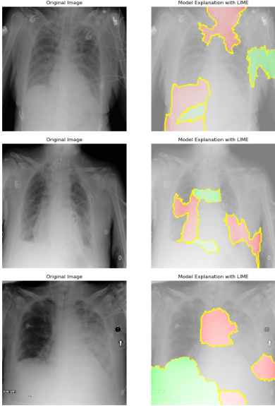

Slide 46
Conclusion
05

Slide 47
Results
Models must be refined before being implemented into hospitals and clinics
Fixed one issue of unbalanced data, however poor accuracies could be due to:
Data quality
Poor choice of model
Overfitting
Notes:
avish

Slide 48
Summary
Over 30,000 images of chest x-rays
Research on the types of catheters.
⅓ of the catheters were malpositioned
CVC is most common type of catheter
We used ResNet50 and the Multi-label Catheter Classification performed best with 73.93%

Slide 49
References
Kolikof, J. (July, 2023). Central Venous Catheter. National Library of Medicine. https://www.ncbi.nlm.nih.gov/books/NBK557798/
Signon, F. (Oct, 2022). Nasogastric Tube. National Library of Medicine. https://www.ncbi.nlm.nih.gov/books/NBK556063/
Ahmed, R. (July, 2023). Endotracheal Tube. National Library of Medicine. https://www.ncbi.nlm.nih.gov/books/NBK539747/
Hosny, A. (Aug, 2018). Artificial intelligence in radiology. National Library of Medicine. https://www.ncbi.nlm.nih.gov/pmc/articles/PMC6268174/
Shim, J. (2024). ‘How to identify a catheter’. Interview by Byron Shim, 20 August.

Slide 50
Thank you!
Do you have any questions?

